Slide 1

A SEMINOR REPORT ON
“IMPROVED REACTIVE POWER CAPABILITY WITH GRID CONNECTED DOUBLY FED INDUCTION GENERATOR”
Submitted to
Department of Electrical Eng.
Submitted By
T. D. S. Reddybabu
M.Tech First year

Slide 2
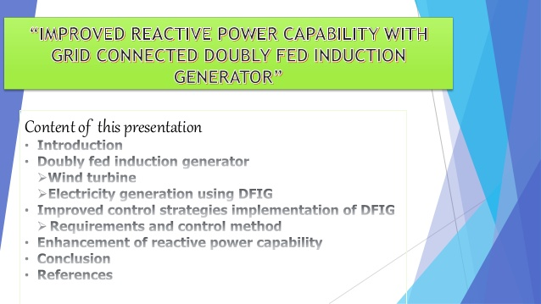

Slide 3
Abstract
Due to increasing wind power generation in the electric power system, the reactive power generation by the wind farms is a major concern during both steady state and faulty conditions. This paper, first, presents the reactive power capability (RPC) curve of doubly-fed induction generator (DFIG) considering three limitations (rotor voltage, rotor current and stator current) for reactive power production/consumption, for the complete operating range which is obtained by optimal rotor speed employing maximum power point tracking (MPPT) algorithm. It is established that the total reactive power generation is limited by rotor voltage at low speeds and by rotor current at higher speed. However, the total reactive power consumption is limited by stator current, for entire operating region. Selection of partial rated converter rating is crucial in terms of cost, efficiency, operating speed range and reactive power capability. The effect of converters rating on the enhancement of RPC of doubly fed induction generation is analysed. Complete capability curves of DFIG for different stator voltages are developed considering grid-side converter (GSC) contribution towards reactive power capability.
Keywords:- Reactive power capability curve, Doubly-fed induction generator, Optimised slip, Wind power generation, Maximum power point tracking

Slide 4
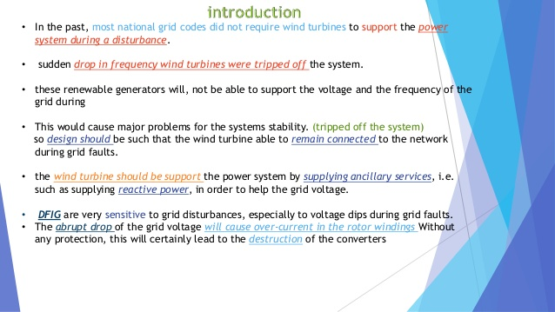

Slide 5
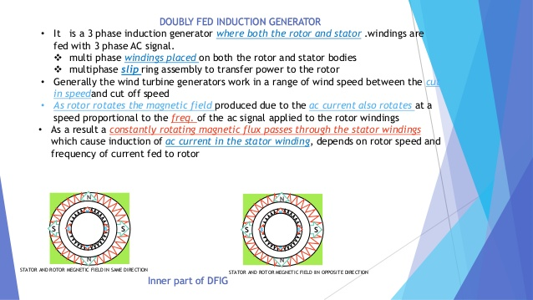

Slide 6


Slide 7
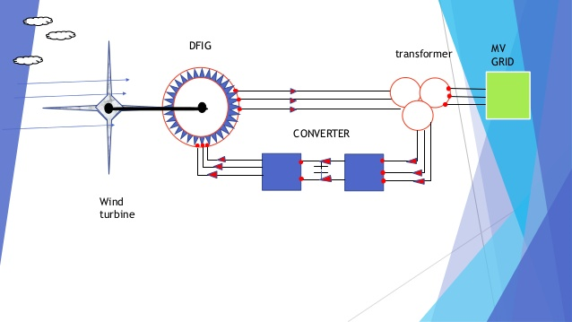

Slide 8
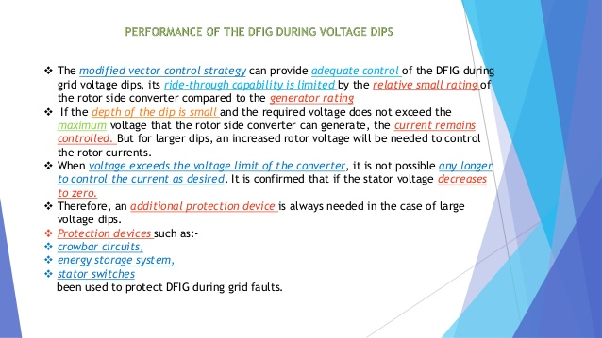

Slide 9
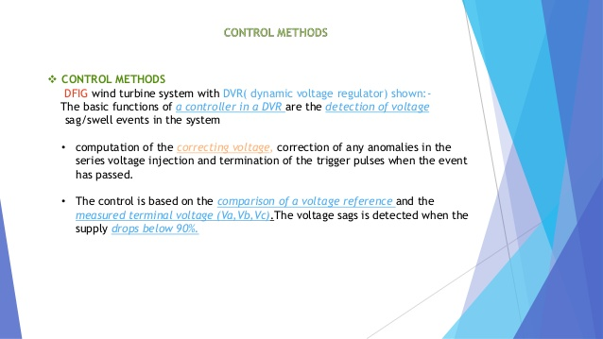

Slide 10
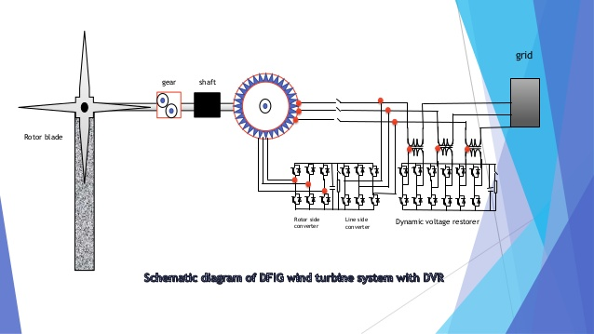

Slide 11
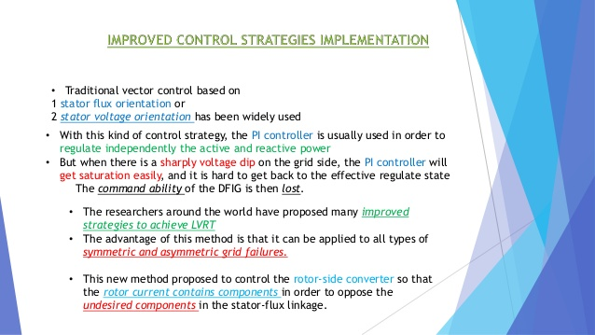

Slide 12
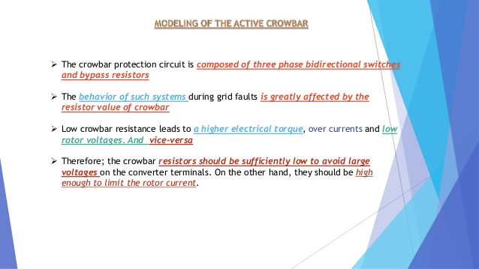

Slide 13
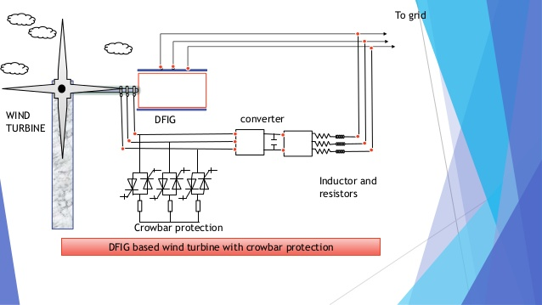

Slide 14
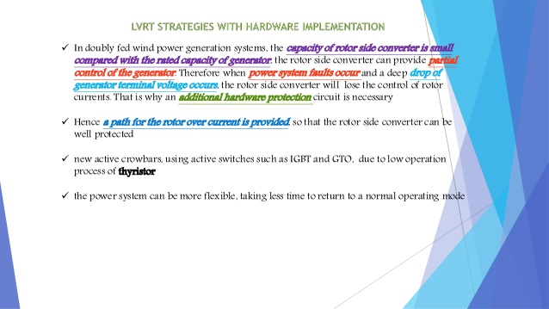

Slide 15
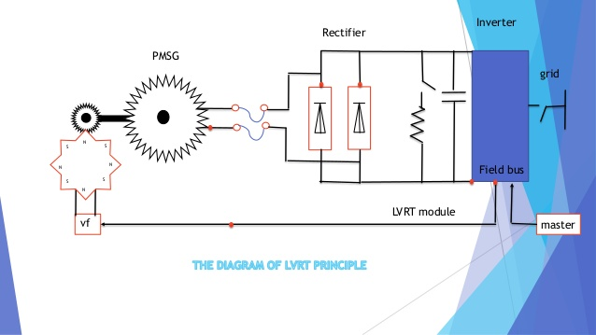

Slide 16
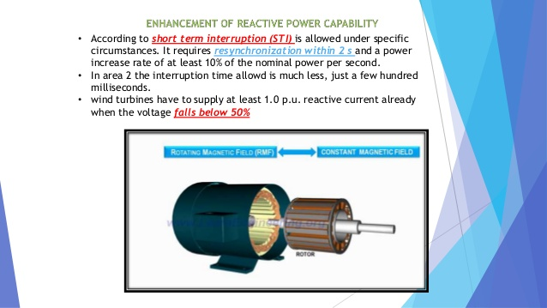

Slide 17
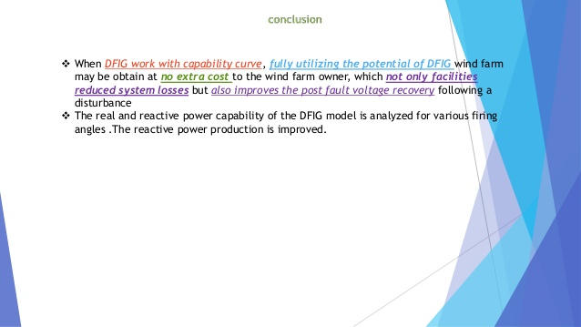

Slide 18


Slide 19


